Slide 1
Bilinear CNNs for Fine-grained Visual Recognition
Tsung-Yu Lin, Aruni RoyChowdhury, Subhransu Maji
ICCV 2015

Slide 2
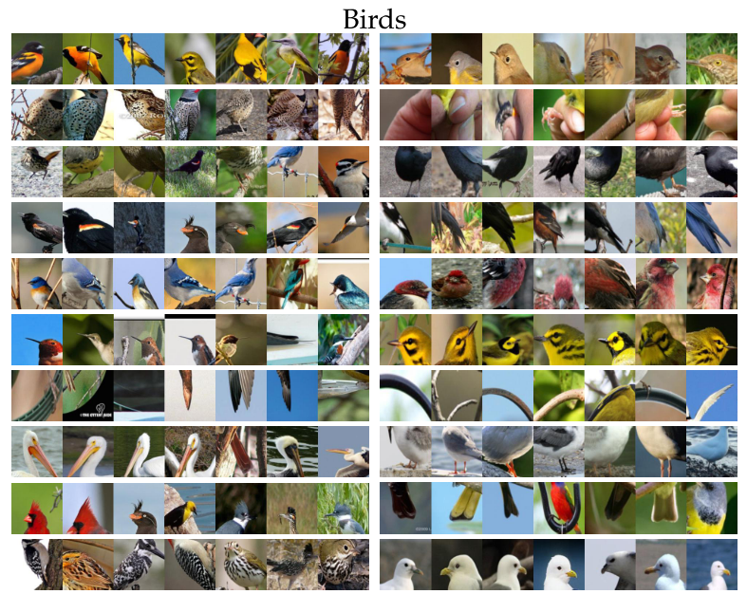
Fine-Grained Recognition
Classification of instances within a subordinate category.
Require recognition of highly localized attributes of objects while being invariant to their pose and location in the image.

Slide 3
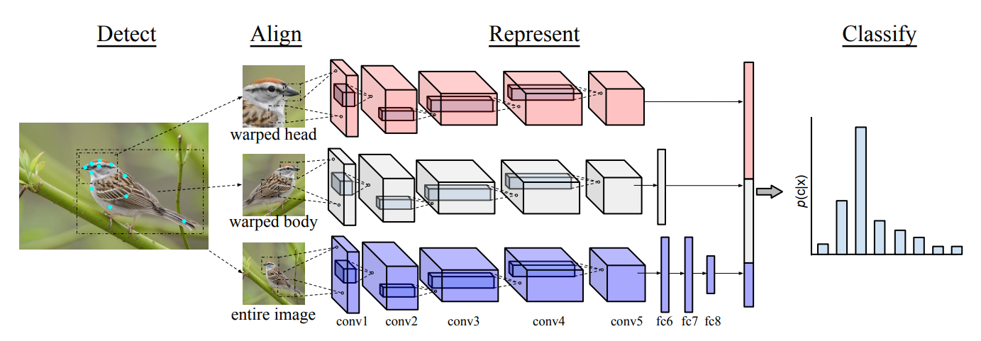
Part-based Models
Construct representations by localizing parts and extracting features conditioned on detected locations.
Pros: more accurate, invariant to position and pose of the object
Cons: require annotations

Slide 4
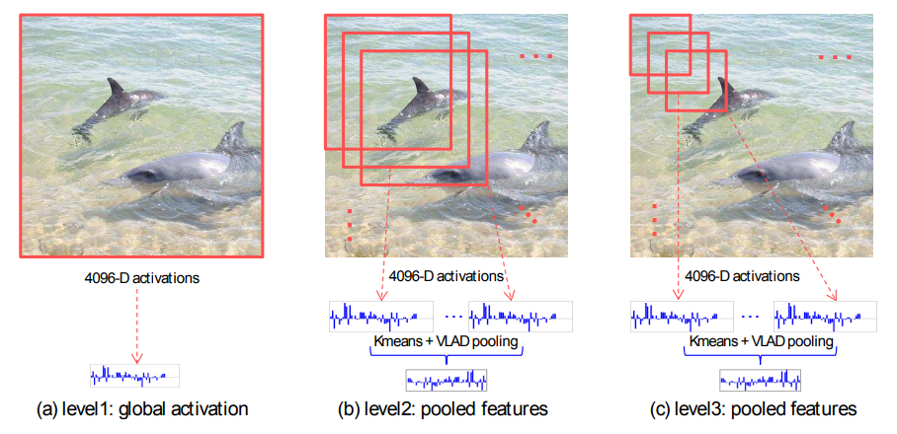
Holistic Models
Construct a representation of the entire image.
Pros: doesn’t require part annotations
Cons: can’t learn in an end-to-end manner, leads to suboptimal texture representations.

Slide 5
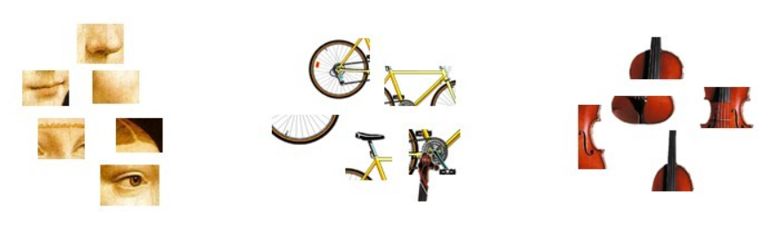
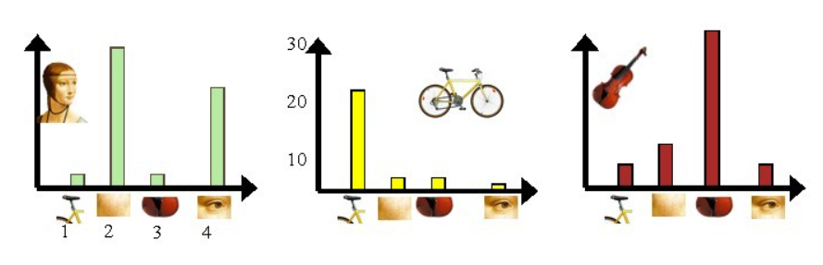
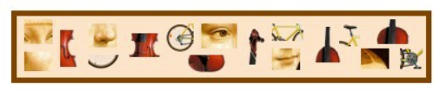
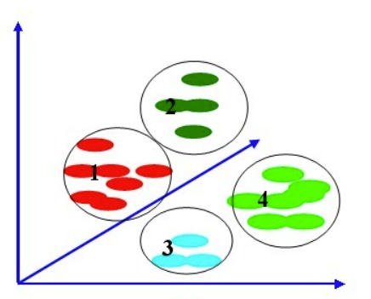
Bag of Visual Words
1. Get visual words from each image.
2. Summarize all visual words.
4. Represent each image by an histogram.
3. Cluster visual words by K-means.

Slide 6
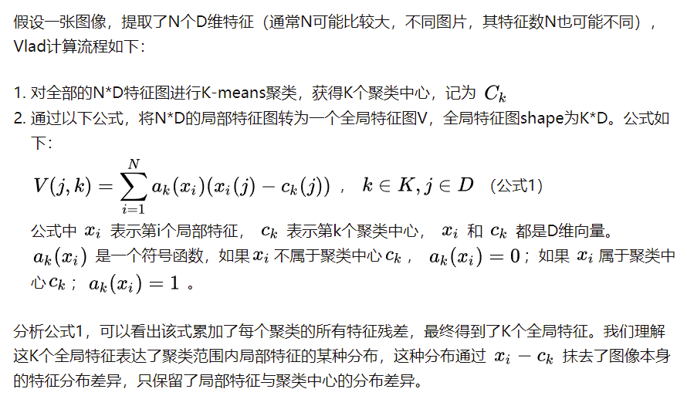
VLAD

Slide 7
Contribution
We present Bilinear CNNs (B-CNNs) that address several drawbacks of existing deep texture representations.
Our key insight is that several widely-used texture representations can be written as a pooled outer product of two suitably designed features, and can be implemented by a specially designed bilinear layer and a pooling layer.

Slide 8
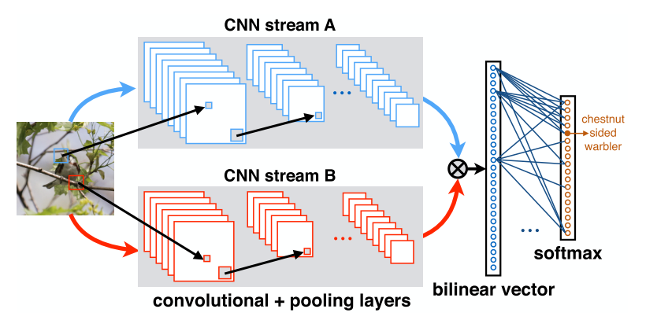
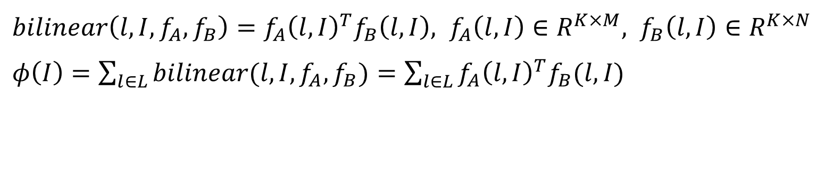
B-CNN Architecture
$bilinear\left(l,I,f_{A},f_{B}\right)=f_{A}{\left(l,I\right)}^{T}f_{B}\left(l,I\right), f_{A}\left(l,I\right)∈R^{K×M}, f_{B}\left(l,I\right)∈R^{K×N}$
$φ\left(I\right)=\sum_{l∈L}{bilinear(l,I,f_{A},f_{B})}=\sum_{l∈L}{f_{A}{\left(l,I\right)}^{T}f_{B}(l,I)}$

Slide 9
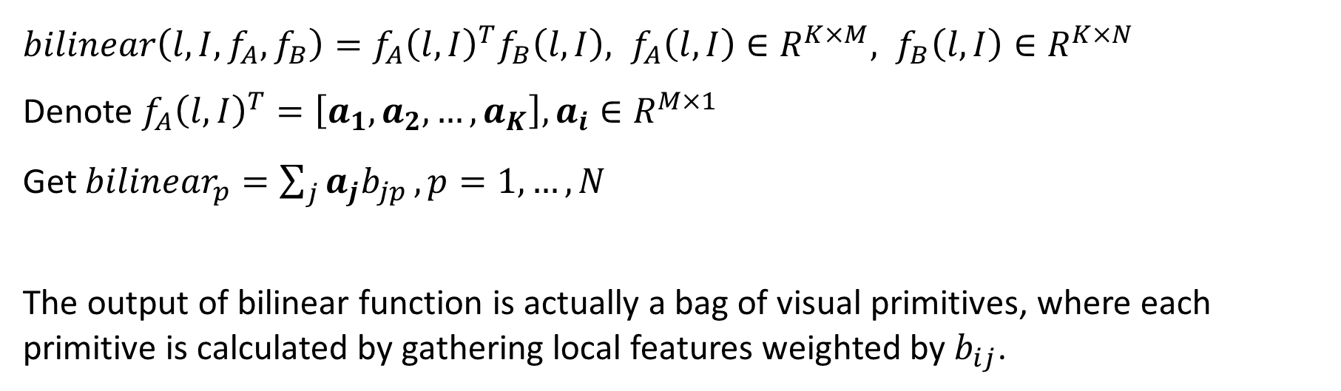
Understanding of Bilinear Function
$bilinear\left(l,I,f_{A},f_{B}\right)=f_{A}{\left(l,I\right)}^{T}f_{B}\left(l,I\right), f_{A}\left(l,I\right)∈R^{K×M}, f_{B}\left(l,I\right)∈R^{K×N}$
Denote $f_{A}{\left(l,I\right)}^{T}=\left[a_{1},a_{2},…,a_{K}\right], a_{i}∈R^{M×1}$
Get $bilinear_{p}=\sum_{j}{a_{j}b_{jp}}, p=1,…,N$
The output of bilinear function is actually a bag of visual primitives, where each primitive is calculated by gathering local features weighted by $b_{ij}$.

Slide 10
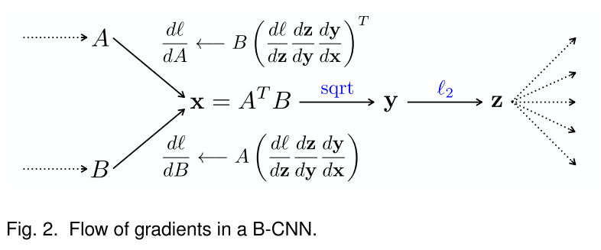
End-to-end Training
The bilinear form simplifies the gradient computations.

Slide 11
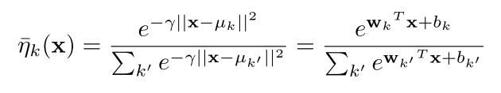
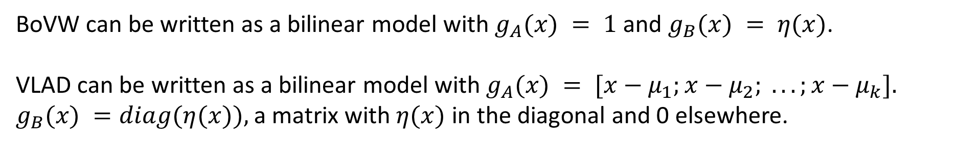
Relation to Classical Texture Representations
BoVW can be written as a bilinear model with $g_{A}(x) = 1$and $g_{B}(x) = η(x)$.
VLAD can be written as a bilinear model with $g_{A}(x) = [x−μ_{1};x−μ_{2}; . . . ;x−μ_{k}].$
$g_{B}(x) =diag(η(x)),$a matrix with $η(x)$ in the diagonal and 0 elsewhere.

Slide 12
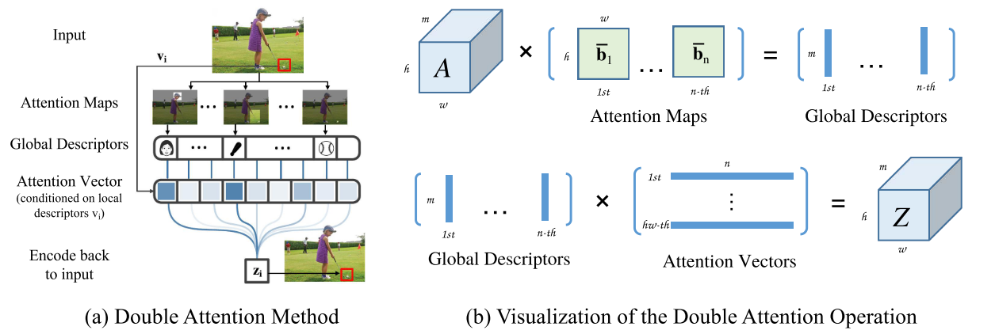
A2-Nets: Double Attention Networks (NIPs 2018)
$G_{binilear}\left(A,B\right)=A^{T}B, A∈R^{hwd×m},B∈R^{hwd×n}$ to get n global descriptors.

Slide 13
Thanks
Kang Xin

